Slide 1
EE P 596 Presentation: The Veggie Classifier
Presented By: Blake Downey

Slide 2
PROBLEM STATEMENT
I propose a transfer learning problem with a self generated dataset to classify five types of vegetables which was extended to have two versions, the second with the addition of a sixth vegetable and more training and test images:
Bell Peppers, Broccoli, Cauliflower, Cucumber, Mushrooms + Zucchini in version two
Check it out: https://github.com/bdowney49/veggie-classifier

Slide 3
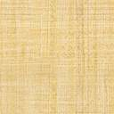
PROJECT SUMMARY
V1 - 5 categories
Baseline results with a pre-trained ResNet-34
3 cases (case 0, 1 & 2) of successively deeper transfer learning
Results of each case’s fully trained model by category for baseline comparison
V2 - 6 categories
Baseline results with a pre-trained ResNet-34
Best case from V1 (case 2) trained on V2 train data
Results of fully trained model by category for baseline comparison
Notes:
15 original images per category -- V1
20 original images per category -- V2

Slide 4
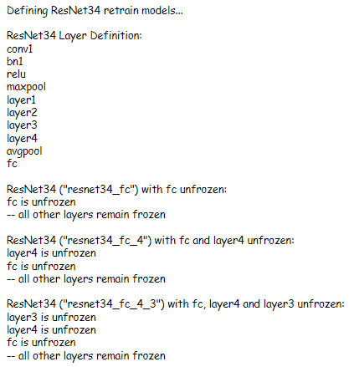
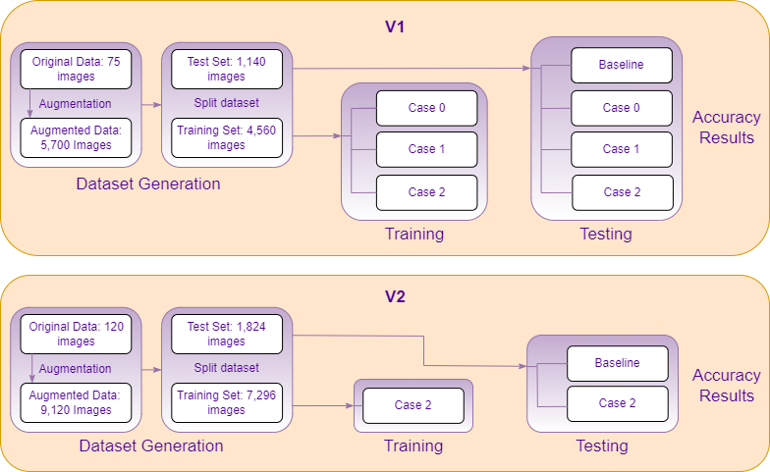
PROPOSED METHOD
The 3 cases of V1:
Case 0: ‘resnet43_fc’
Case 1: ‘resnet43_fc_4’
Case 2: ‘resnet43_fc_4_3’

Slide 5
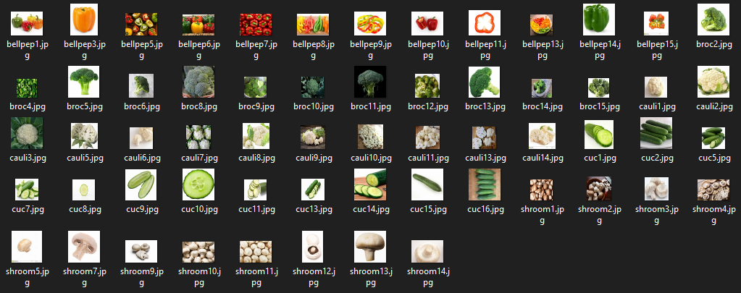
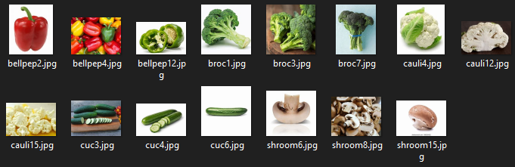
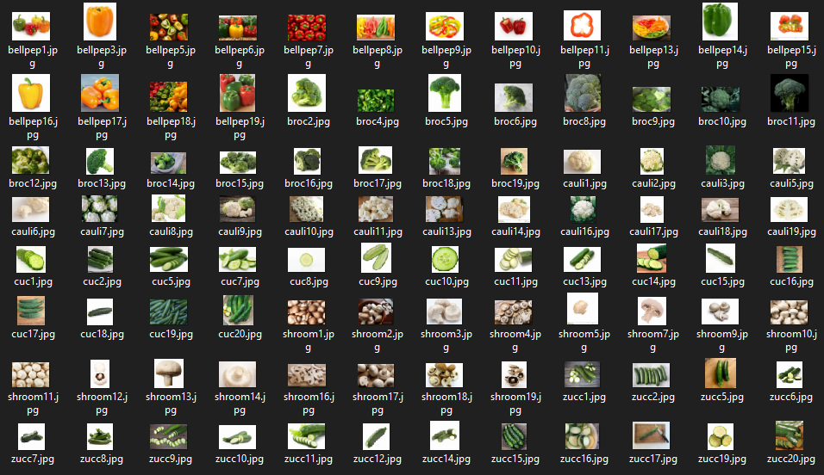
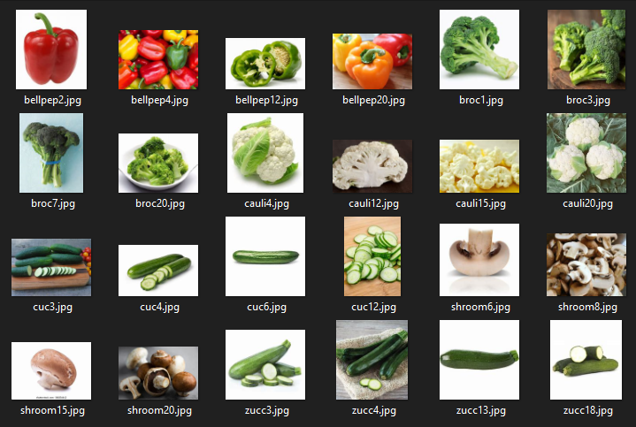
Datasets
V1 Train and Test Images
V2 Train and Test Images

Slide 6
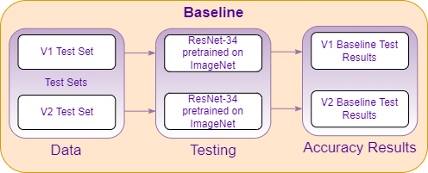
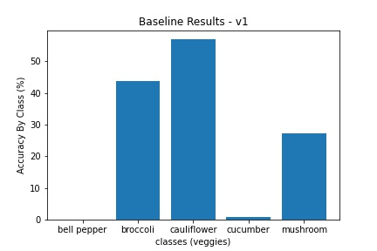
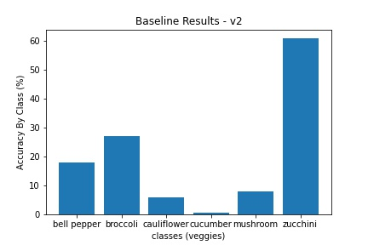
BASELINE

Slide 7
RESULTS – TOTAL ACCURACY
Comparing results below with V1 and V2 Baseline vs cases:
Method | Total Accuracy %
V1 - Baseline | 25.79
V1 - Case 0 | 83.67
V1 - Case 1 | 88.40
V1 - Case 2 | 93.85
V2 - Baseline | 20.02
V2 - Case 2 | 88.04

Slide 8
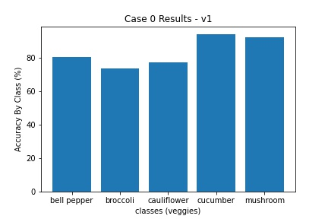
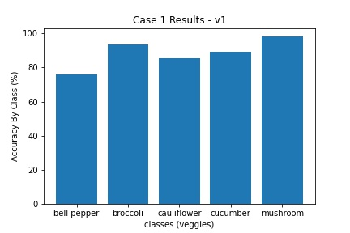
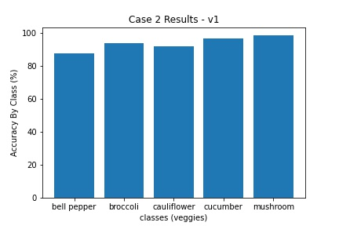
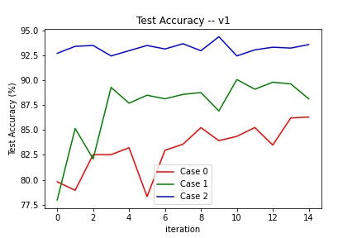
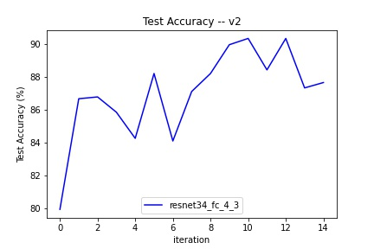
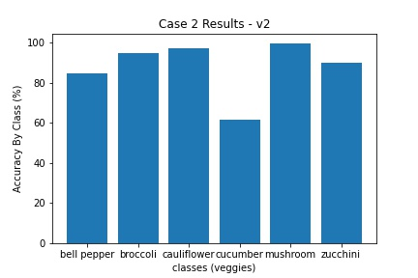
RESULTS – TOTAL ACCURACY CONT...

Slide 9
CONCLUSION
I gathered images of vegetables and used data augmentation functions I wrote to generate more images for training and testing
I used 3 cases of sequentially deeper retraining of ResNet-34 backbone on my dataset
Case 2 (‘resnet34_fc_4_3’) performed the best in V1 and was the setup that was used for V2 as well
Addition of Zucchini in V2 lowered cucumbers individual accuracy greatly which caused lower total accuracy of the network
Future Work:
Using my dataset (with possible expansion) and do a time and accuracy comparison between a small convolutional network and the equivalent size and function frequency domain neural network

